Slide 4
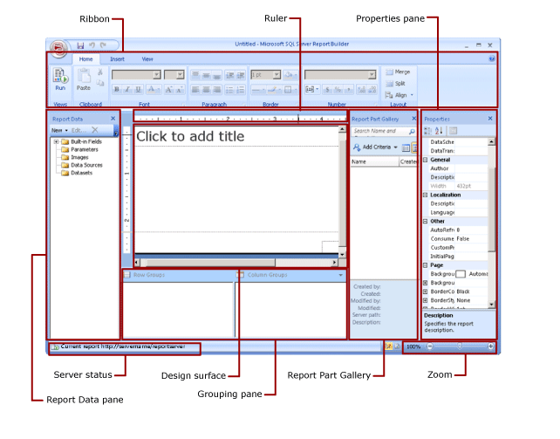

Slide 5
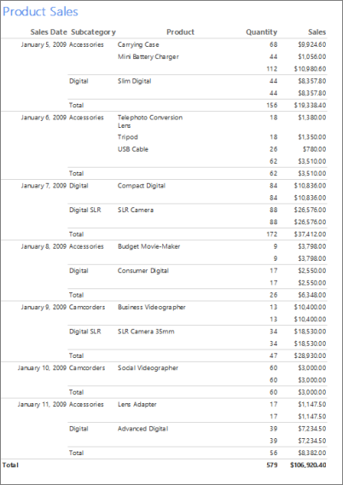
1. Table Wizard

Slide 6
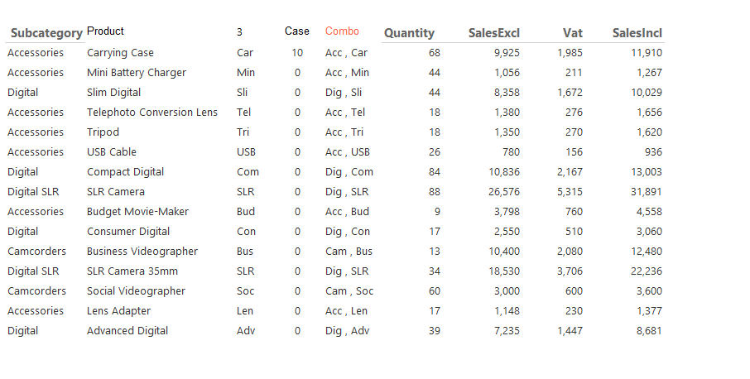
Expressions

Slide 7
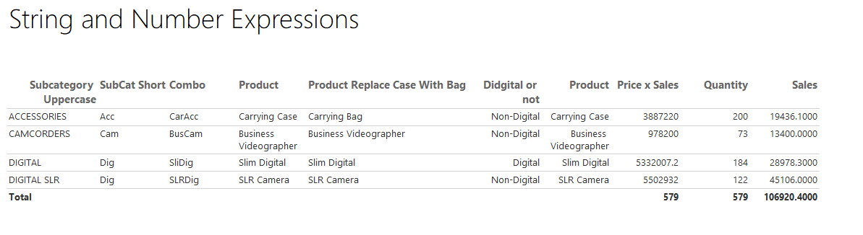
Expressions

Slide 8
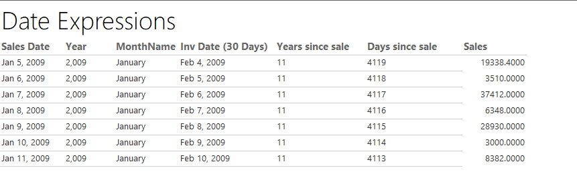
Date Expressions Report

Slide 9
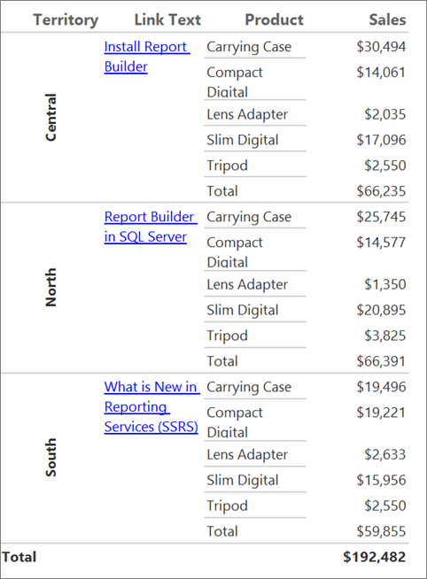
2 Format Text

Slide 10
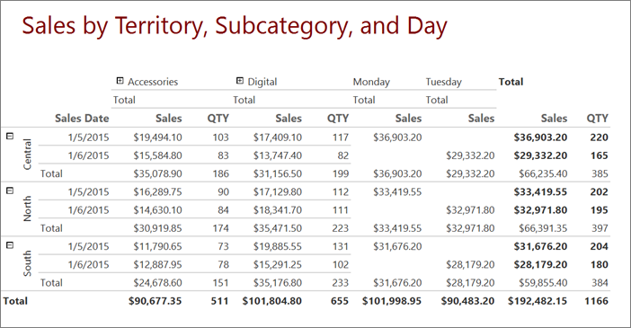
3 Matrix

Slide 11
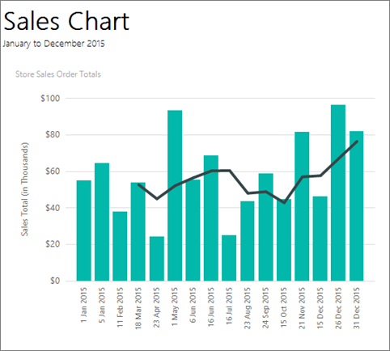
4. Column

Slide 12
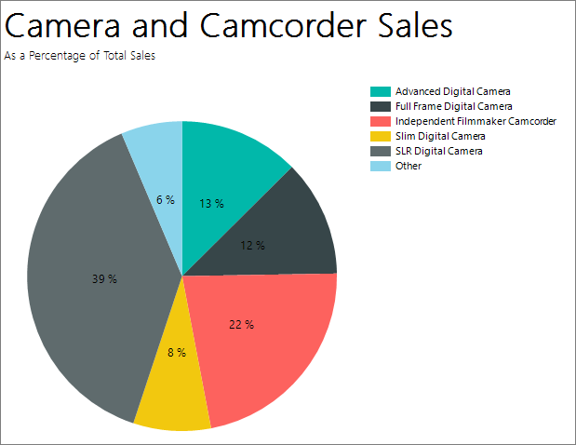
Pie

Slide 13
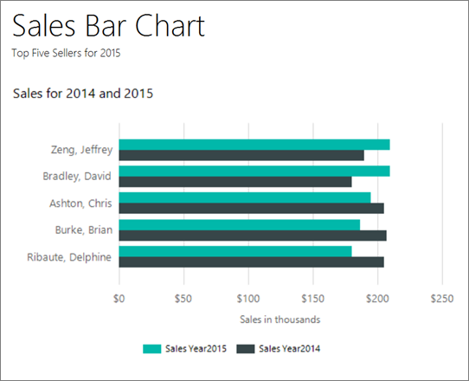
6. Bar

Slide 14
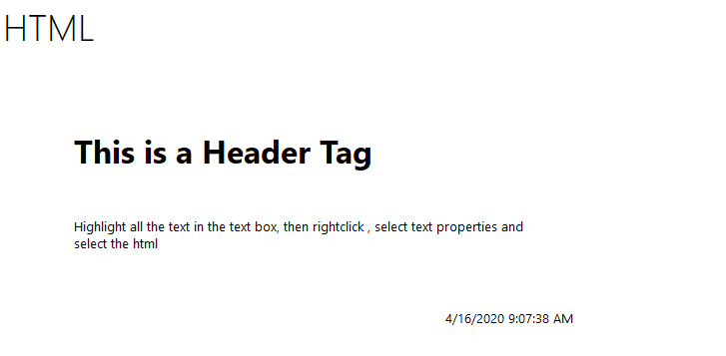
HTML

Slide 15
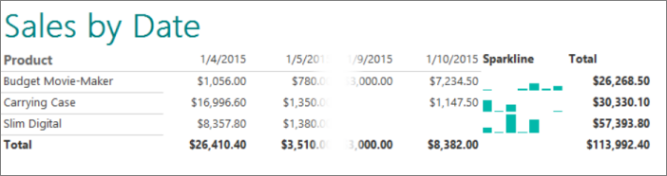
7. SparkLine

Slide 16
Spark Line

Slide 17
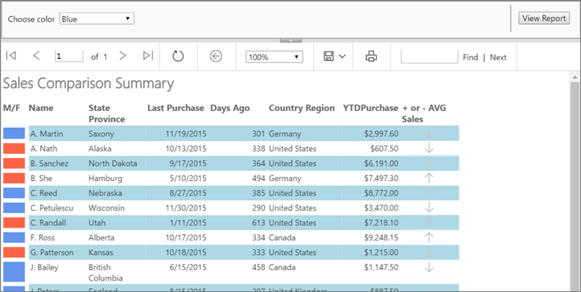
8. Expressions

Slide 18
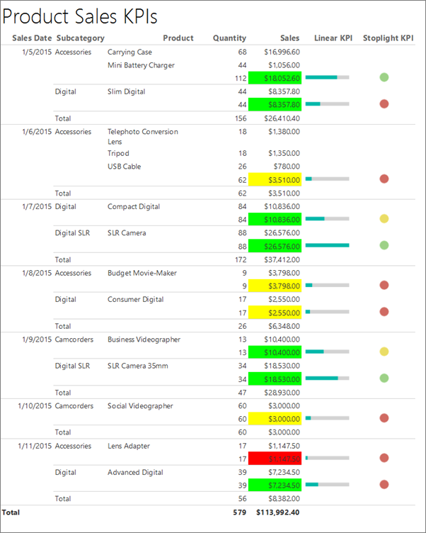
9. KPI

Slide 19
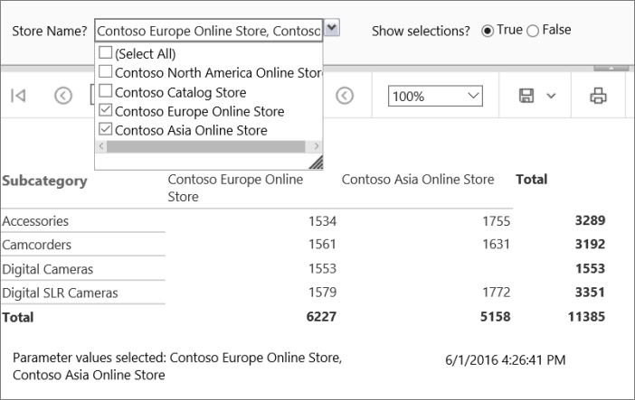
10. Parameter

Slide 20
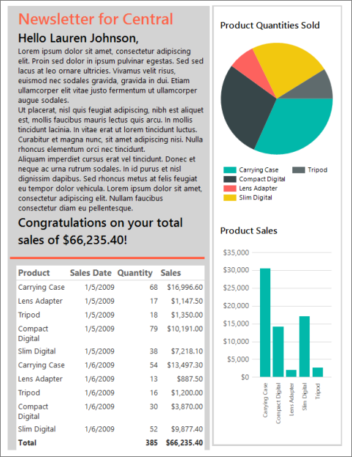
11. Free Format Report

Slide 21
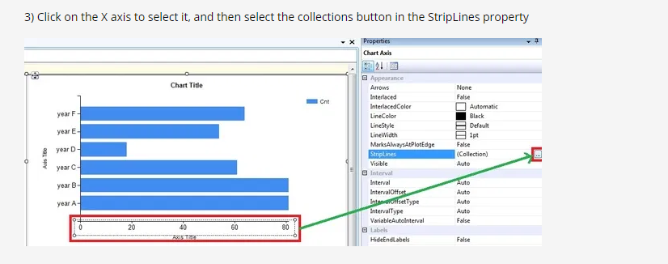
Strip Line – Target Line on Chart, step1
http://sqljason.com/2011/11/adding-target-line-to-horizontal-bar.html

Slide 22
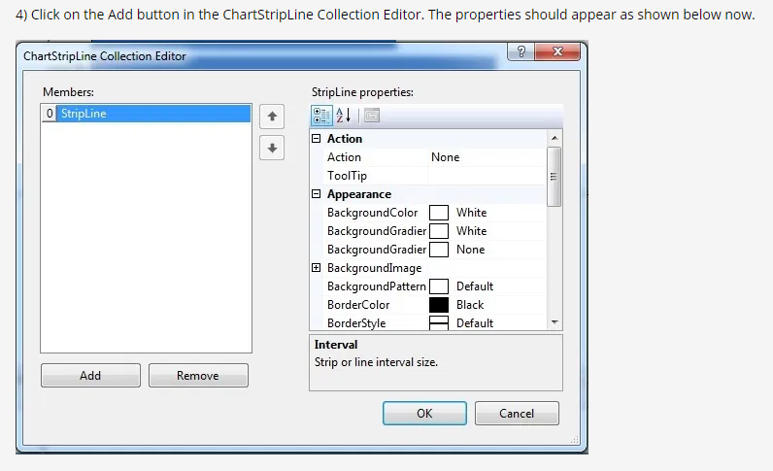
Strip Line – Target Line on Chart, step2

Slide 23
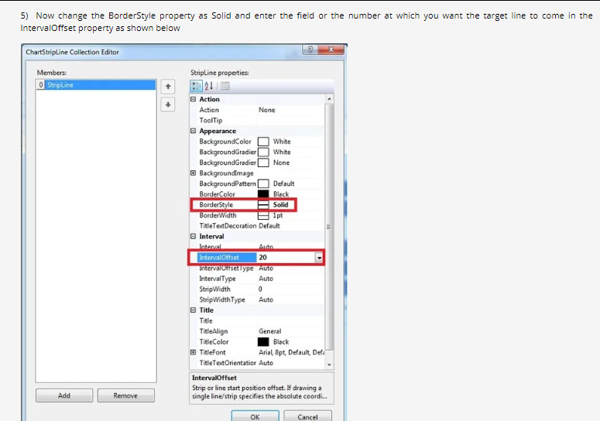
Strip Line – Target Line on Chart, step3

Slide 24
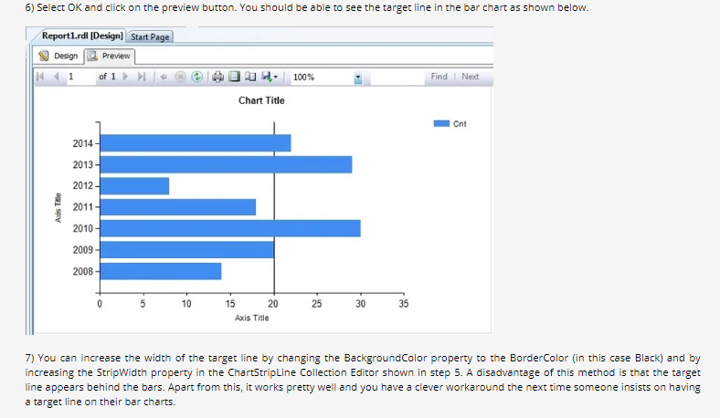
Strip Line – Target Line on Chart, step4

Slide 25
Add Collapse buttons
How to add collapse buttons to a table
Go to snagit folder for video

Slide 26
Resources
http://sqljason.com/2013/05/a-sample-ssrs-dashboard-and-some-tips.html
https://www.mssqltips.com/sqlservertutorial/9084/sql-server-reporting-services-ssrs-2017-deployment-and-implementation/

